Slide 1
Advanced Java Concepts - Assignment IV
BY: Rishika Kumari
1852

Slide 2
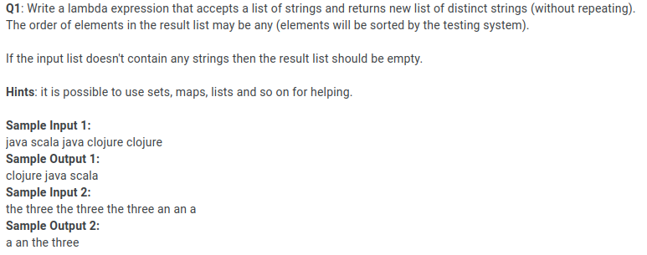
Question:

Slide 3
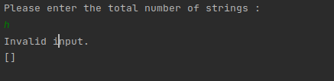
Outputs: InputMismatchException handled.

Slide 4
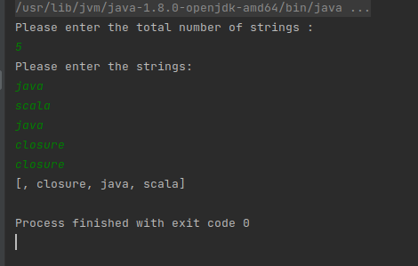
Outputs:

Slide 5
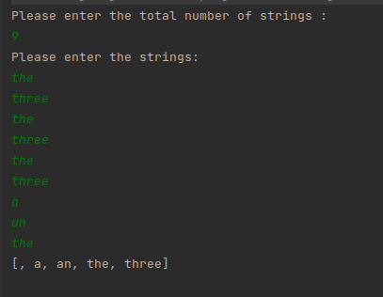
Output:

Slide 6
THANK YOU!

